Slide 1
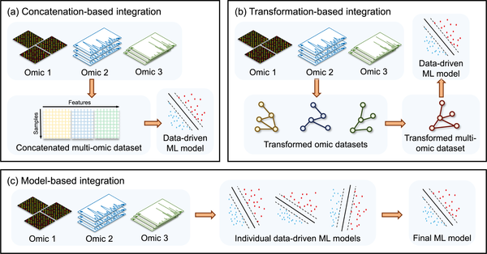
Fig 1. Omic data–integration methods in machine learning.
Zampieri G, Vijayakumar S, Yaneske E, Angione C (2019) Machine and deep learning meet genome-scale metabolic modeling. PLOS Computational Biology 15(7): e1007084. https://doi.org/10.1371/journal.pcbi.1007084
https://journals.plos.org/ploscompbiol/article?id=10.1371/journal.pcbi.1007084

